Slide 1
CREATE APPEAL
Your Best
Approach to Health (Post 8)

Slide 2
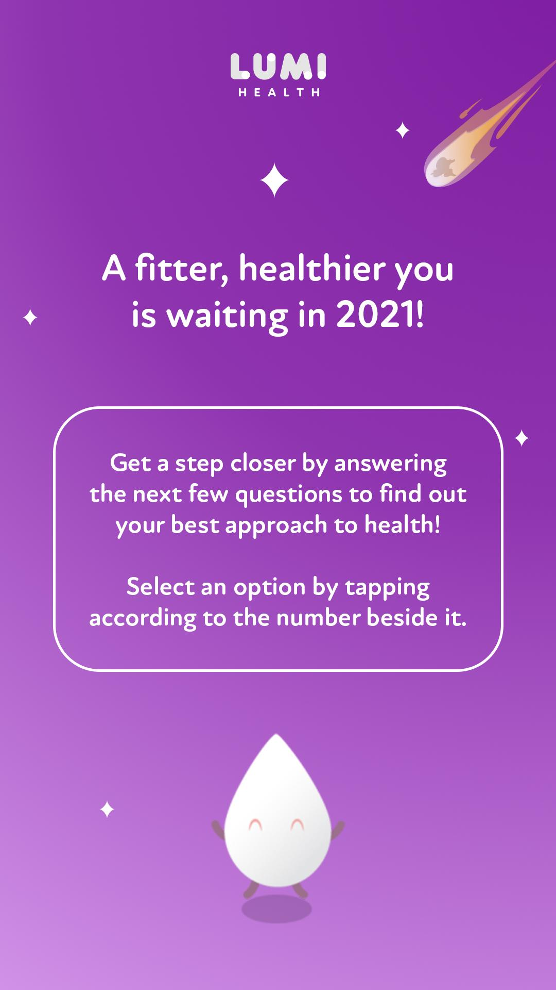
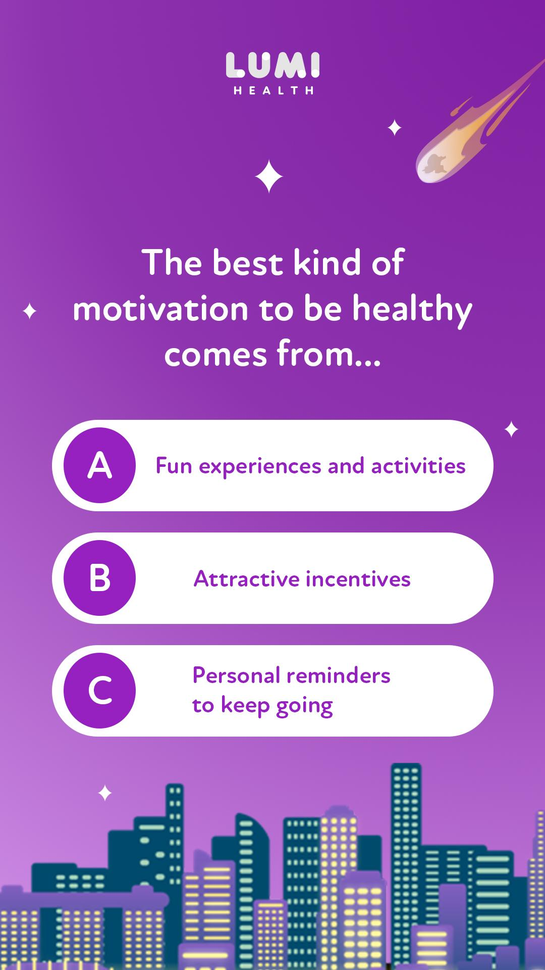
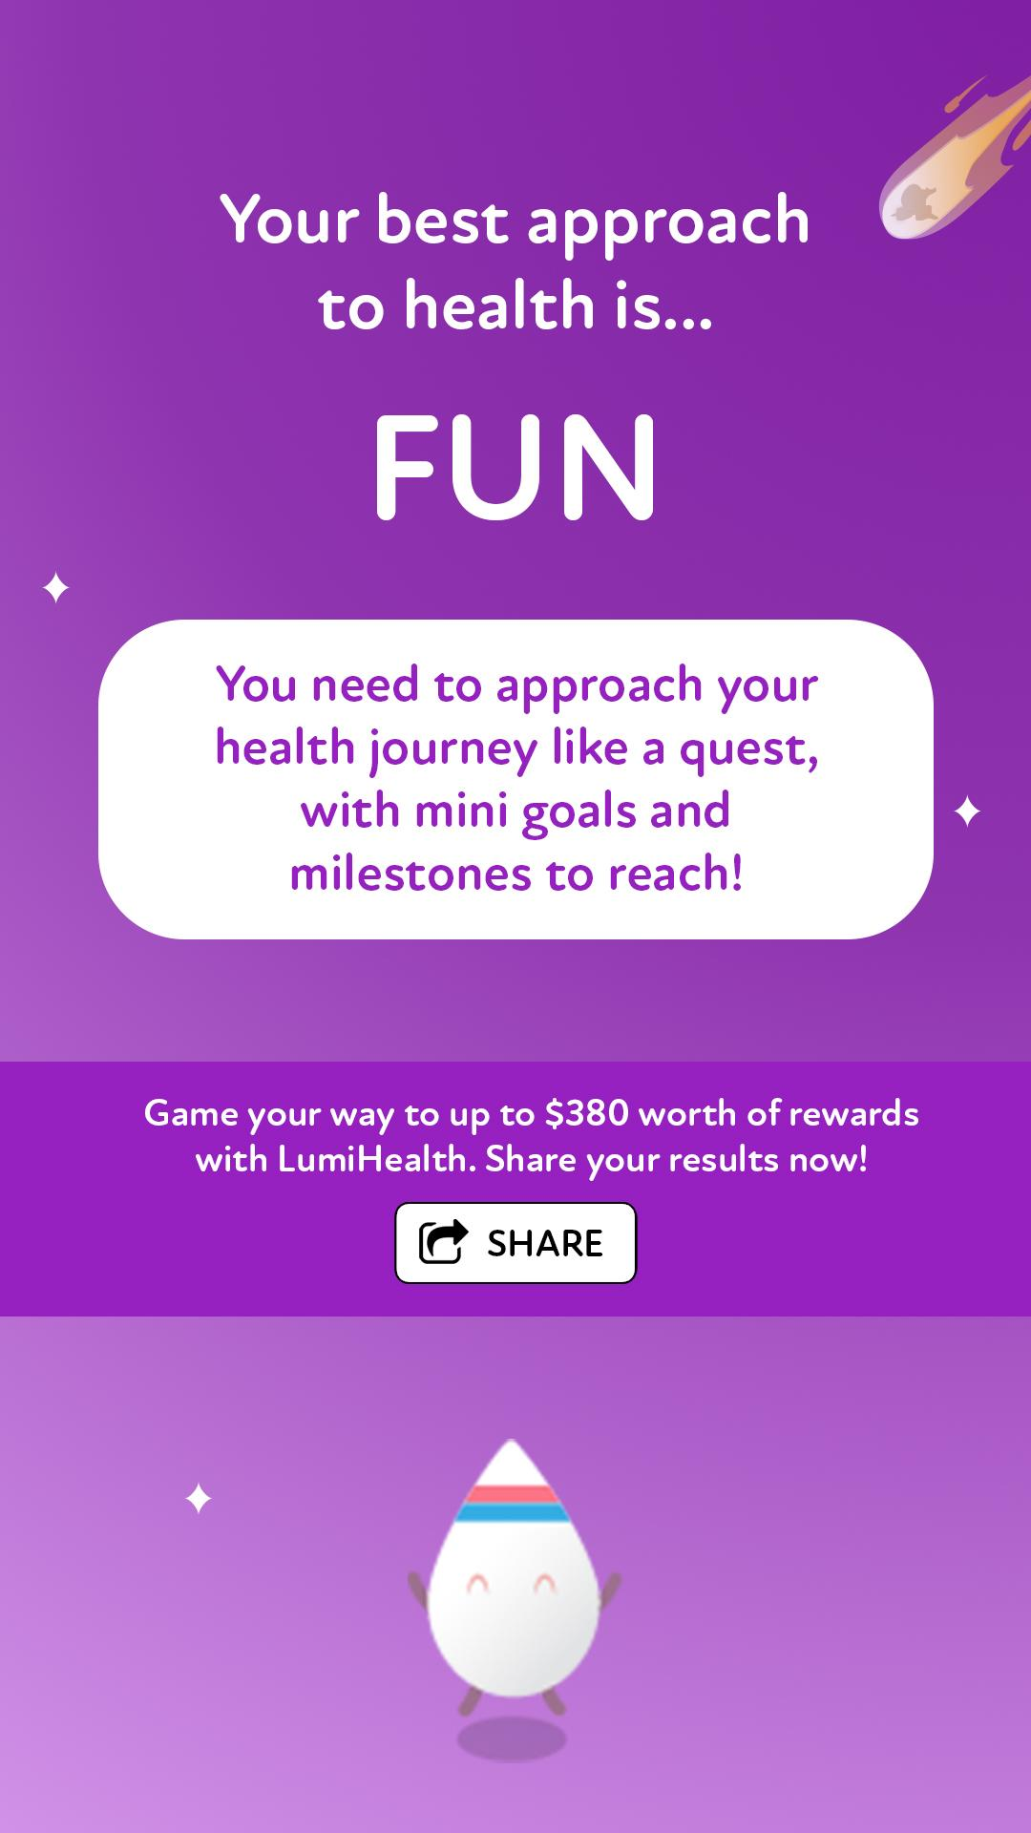
A mini quiz could be created for people to find out how they can approach their health based on LumiHealth’s 3 pillars. This could be hosted on Newsfeed Smartapps, boosted as a post on Facebook.
LEVERAGING THE COMMUNITY |
Always-on

Slide 3
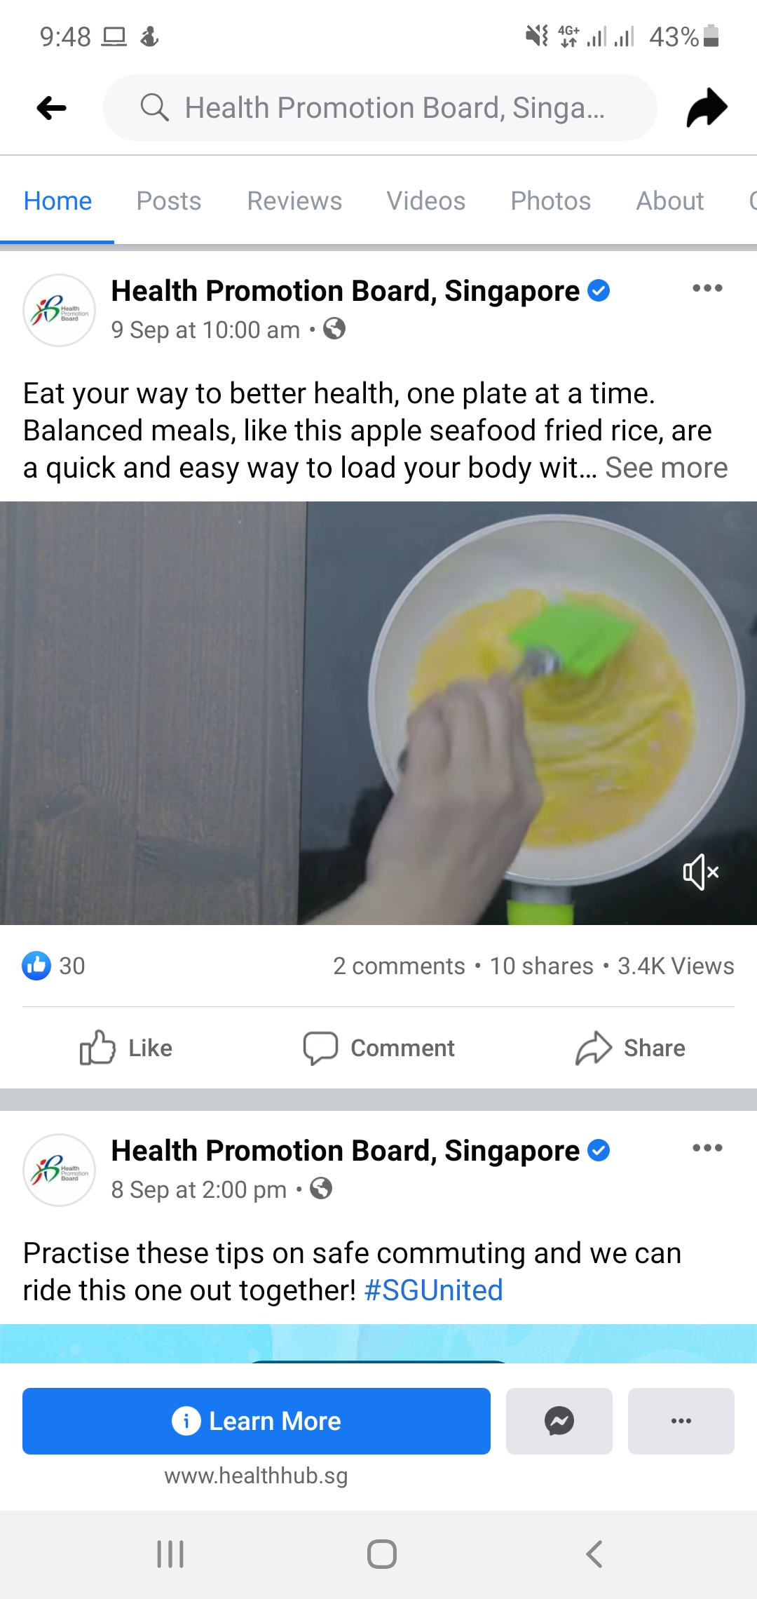
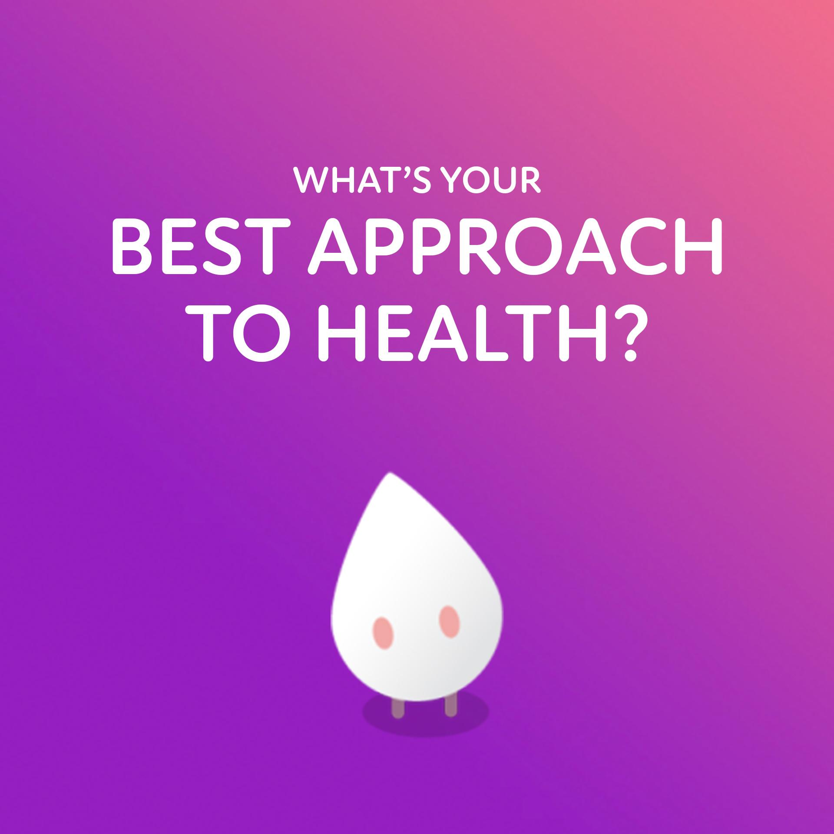
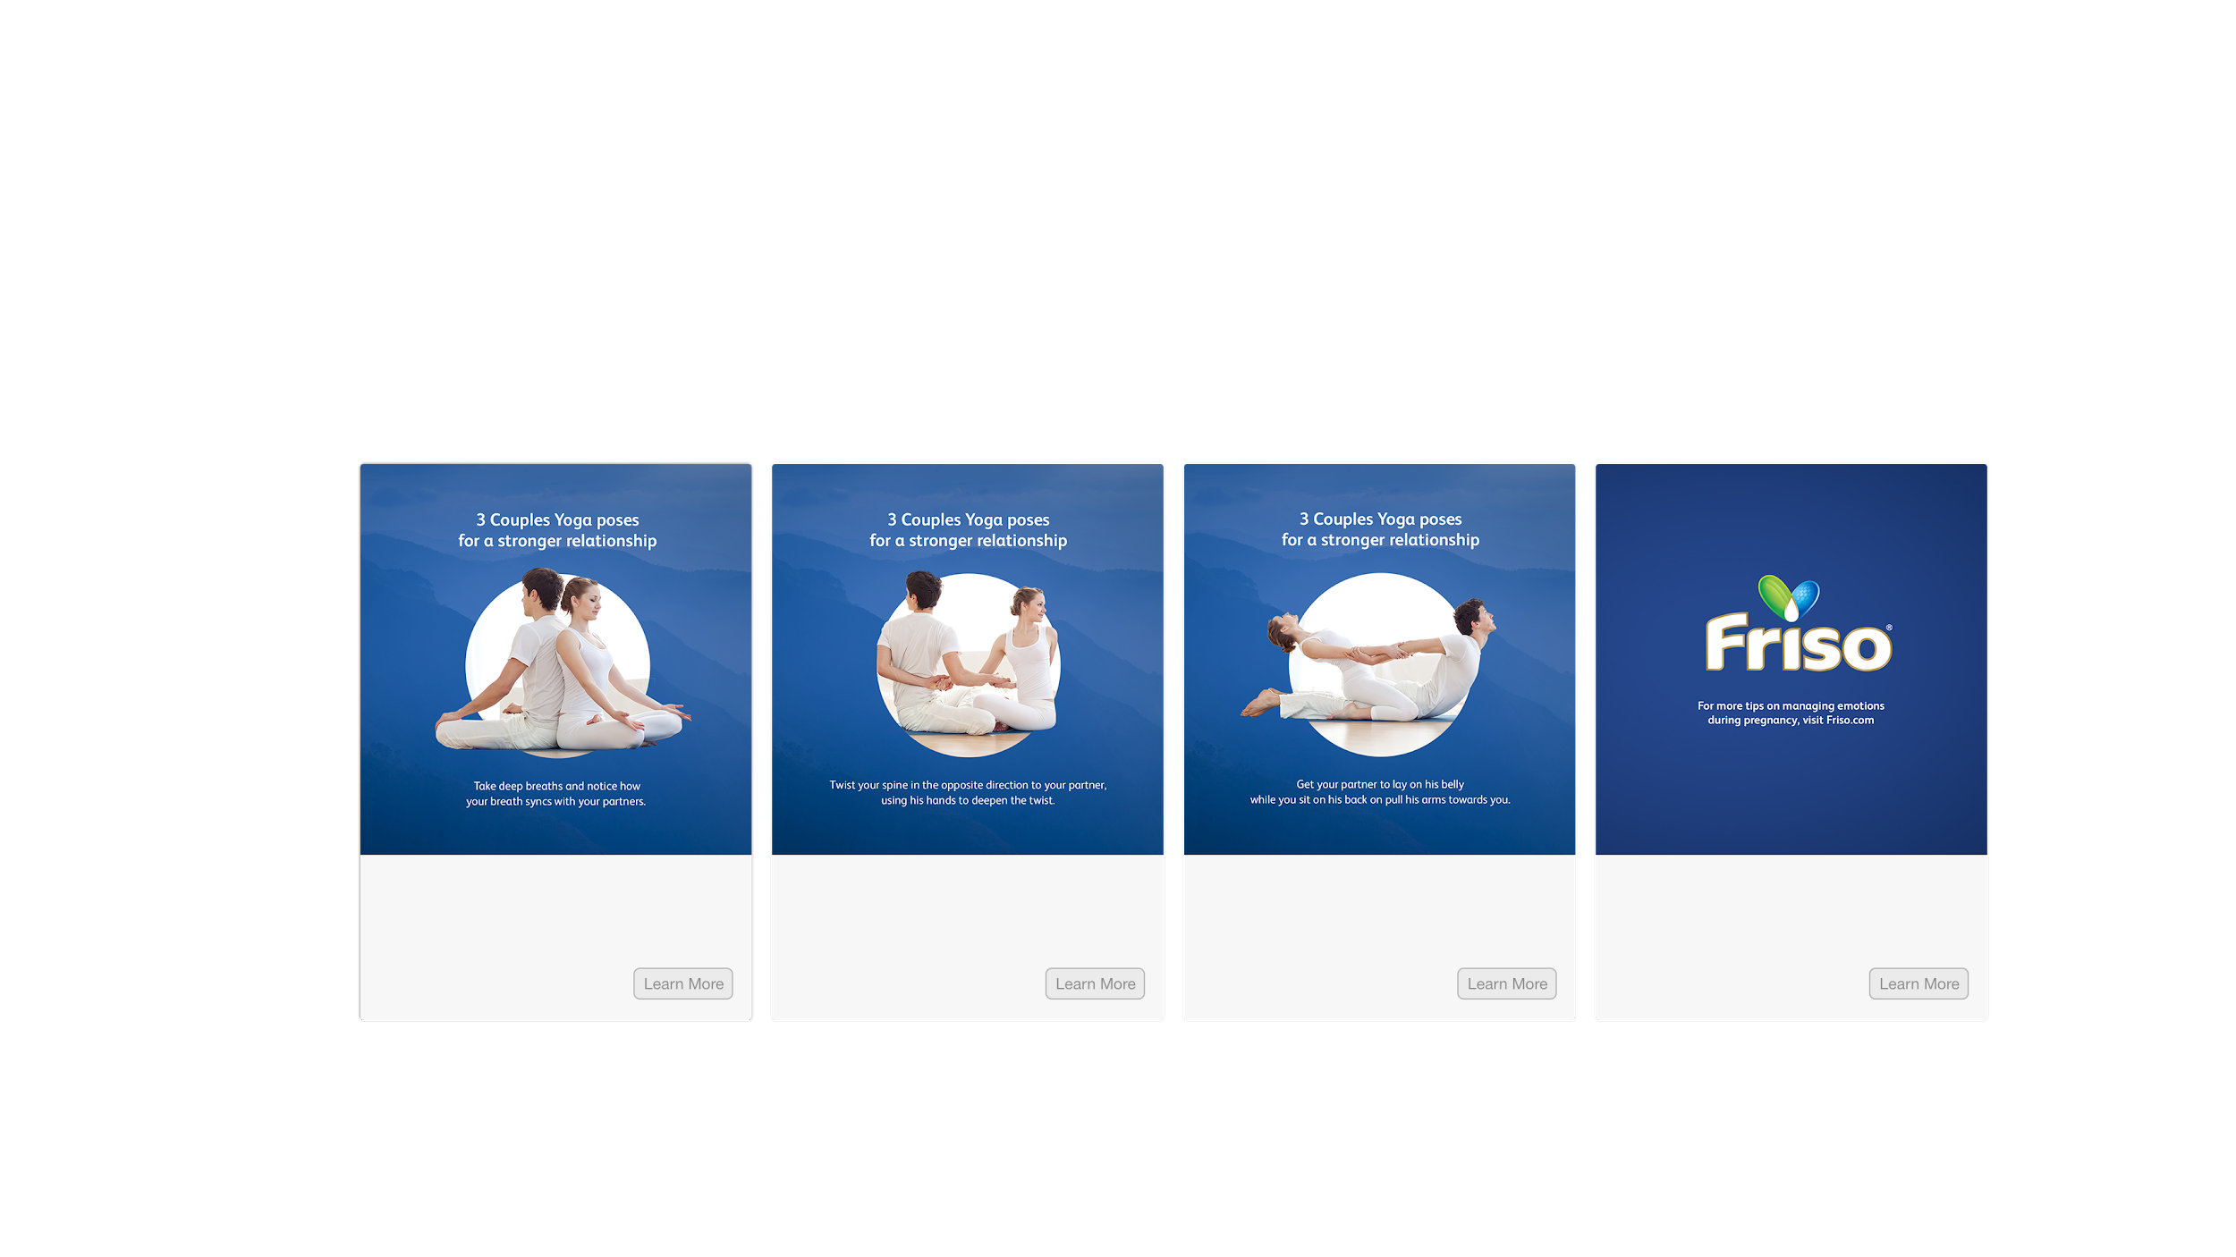
Rather than having two CTAs within the end of the quiz’s endframe, we could share the NFSA quiz as a Facebook link post, where we can push people to download the app.
If you’ve been thinking about improving your health but don’t know where to start, take this quiz to see how LumiHealth can best help you reach your goals!
Glo is on a quest to find Cyan Crystal, the life force of his people. He noticed that there’s an abundance of Lumi on Earth, a fuel that keeps Glo going. Help Glo with his quest and be rewarded with up to $380 worth of vouchers!
Experience a whole new world with Glo!
Level up your health Download the Lumihealth app
Download
LEVERAGING THE COMMUNITY |
Always-on

Slide 4


For the animation of the background, we can have the stars blinking in the night sky as meteorites/shooting stars falls across and fade away from time to time. The city skyline can also have different window panels of lights flashing / turning on and off.
LEVERAGING THE COMMUNITY |
Always-on

Slide 5
5 Quiz Questions
*If mostly a) - Games; mostly b) - Rewards; mostly c) - Personalisation
I will be motivated to keep a healthier lifestyle if there are...
fun experiences and activities
attractive incentives
personal reminders to keep going
I will be motivated to exercise more if…
there are goals and milestones to achieve
I can earn activewear
vouchers
there are workout challenges tailored for me
I will be more likely to choose healthier meals if..
it’s part of a daily challenge
It means I can get grocery shopping vouchers
I’m given specific recommended guidelines on what’s good for me
I will be more likely to get 7-9 hours of sleep daily if…
clocking sleep hours feels like a mission in a quest
I get rewarded for clocking sufficient sleep hours
I get recommended actions that help me to build good sleep habits
I will be more inclined to go for health screening if…
my friends were also going
it earns me some kind of tangible reward
I get recommendations for what I need
LEVERAGING THE COMMUNITY |
Always-on

Slide 6
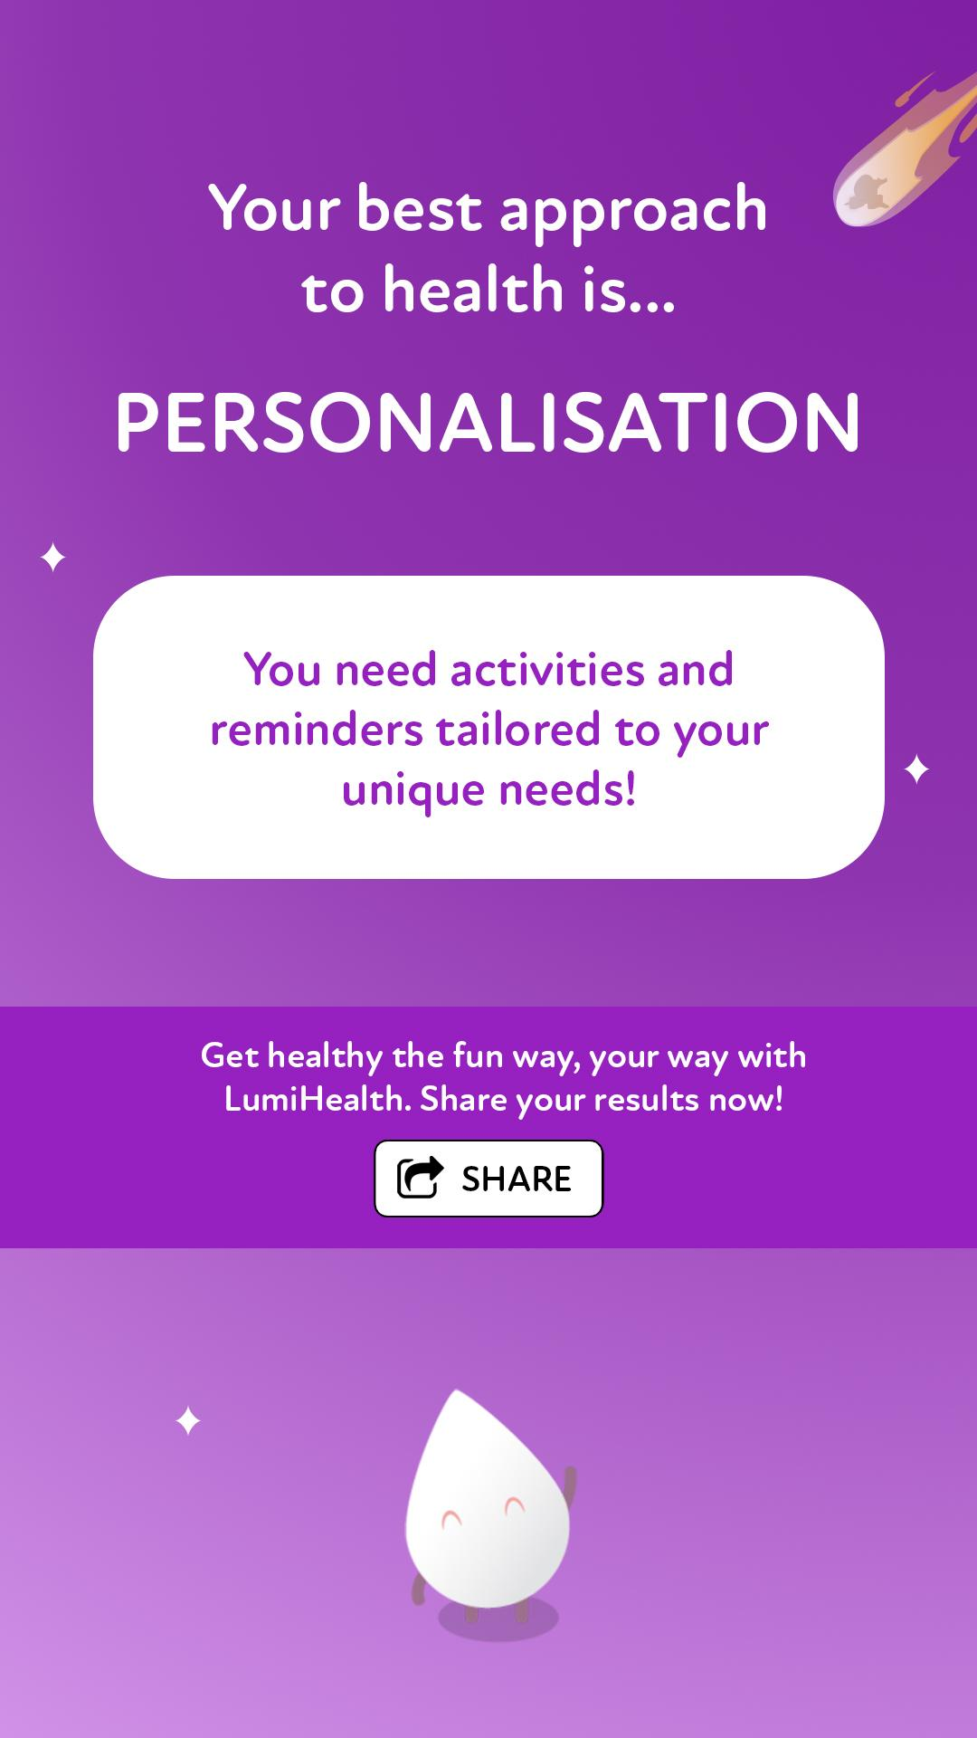
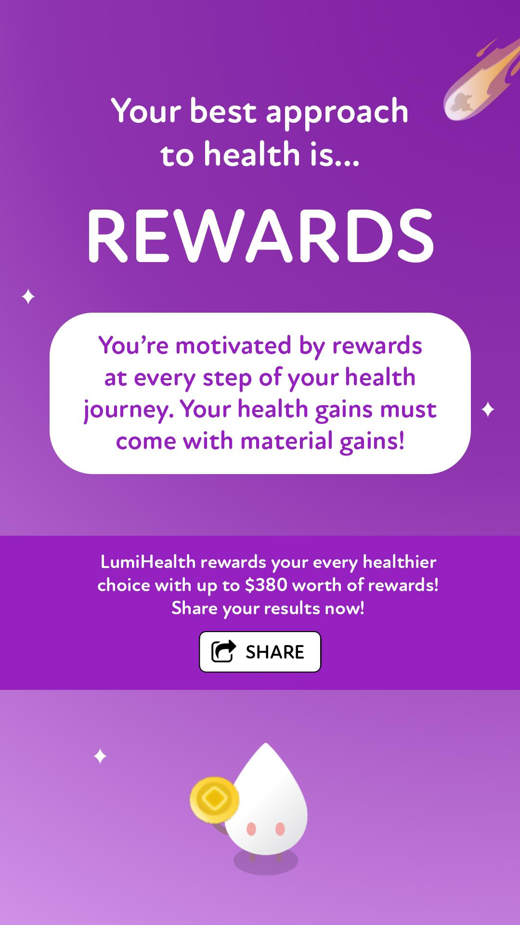
Personality Results
Option 2
LEVERAGING THE COMMUNITY |
Always-on

